Slide 1
Collections Exception Handling
IN710 OOSD 2017
Session 2.2
Notes:
Still looking at the C# core.
Things you may know something about, but now need to learn more...
Two basically unconnected topics today

Slide 2
Part 1: Collections
Family of built-in data structures for working with sets of homogeneous data elements
Lists, stacks, queues, tables and more
C# calls these ‘collections’
Notes:
In the current version of C#, we have access to a number of built-in data structures for handling sets of data elements
A “family” because they have some common ancestors, and they implement some common interfaces

Slide 3
Generics
ClassName<Type>
List<T> -- its definition looks like this
List<int> intList; -- declare like this
intList = new List<int>(); -- create like this
The Collection classes implement a set of defined interfaces
System.Collections.Generics
Notes:
Previous versions of the language used untyped collections (basically working with everything as an object) which led to bugs
Now we have type-safe classes using the generic approach
You may recognise the syntax from C++/CLI arrays if you have used them
Take care with the declaration. You must state the type in both the declaration and the allocation.
You must also remember the () in the alloc
The collections implement a set of defined interfaces; we will see the various methods they support.
The generic collections are all in namespace system.collections.generics
Today we will talk about the most important ones, and look at a few examples, then we will write some code using them.
A generic class is defined using a syntax that allows the specification of argument type to be deferred until runtime.
This allows software re-use.
When we implement an algorithm, we want to re-use it for different types.
Example: We write a generic method for sorting an array of objects, then call the generic method with an array of any type.
The compiler performs type checking to ensure that the array passed to the sorting method contains only elements of the same type.

Slide 4
Important Collection Classes
List<T>
Stack<T> -- LIFO
Queue<T> -- FIFO
Dictionary<K,V>
Notes:
We will concentrate mostly on List and Dictionary as they are general
There are others, for you to look into
Dictionary is especially interesting. It holds a set of key-value pairs.
So you could have complex objects of some kind, each with a key field or ID and you can organise them (including search) by their ID
This is (obviously) ADT Table.
And, FYI, dictionaries are implemented in C# as….hash tables.

Slide 5
Methods & Properties
All
[ ] | All collections implement indexing as for arrays
Count | The number of elements in the collection
Add(E) | Adds element E (not stacks and queues)
Remove(E) | Removes element E, if it is in the collection (not stacks and queues)
Clear() | Removes all elements
Contains(E) | Boolean
CopyTo() | Copies contents to an array
Sort() | Sorts collection (using quicksort).
Notes:
As we said earlier, all the collection classes provide a set of useful methods.
Here are the most important, there are more – look them up
Indexing is by location for Lists and by key for Dictionaries
Adding and removing behave as appropriate for the collection – that is, stacks are LIFO and queues are FIFO
As we know, except for the primitive data types, to allow sorting the class(es) in the collection must implement Icomparable.

Slide 6
Methods
List only
Insert(newLoc, E) | Inserts element E at location newLoc
IndexOf(E) | Returns the index (location) of element E
RemoveAt(loc) | Removes the item at location loc

Slide 7
Methods
Dictionary Only
Keys | Set of all keys in the dictionary
Values | Set of all values in the dictionary
ContainsKey(k) | Boolean
TryGetValue(k, out holder) | If k is found, the corresponding element is returned in holder
Notes:
Dictionary is an extremely useful data structure.
It is effectively a single-table database
We will look a the dictionary in detail later today and in practical
“out” is essentially “ref”

Slide 8
Collections – As an exercise
Queues (FIFO)
Enqueue()
Dequeue
Peek()
Stacks (LIFO)
Push()
Pop()
Peek()
Notes:
Stack and Queue are two very important ADTs.
They are used to implement things like message buffers and browser back buttons.
They have these formally defined operations
We will be building our own later in the semester, so before then, you should look them up and learn how they work...

Slide 9
Operators
foreach
foreach (elementType e in elementCollection)
{
-- each element is called e in this loop
doSomething(e);
…
}
Notes:
We are all familiar with the foreach operator.
It requires a collection object that implement IEnumerable (in case you want to write your own...)
Assume elementCollection is a member of System.Collections, and it holds items of type elementType…
Hugely powerful. No need to know the size of the collection, or to keep track of where you are.
One large, but subtle advantage is that there are no problems if your doSomething deletes (compared to iterating with an index variable)
Slight quirks with the difference collections, as we will see when we start looking at the code

Slide 10
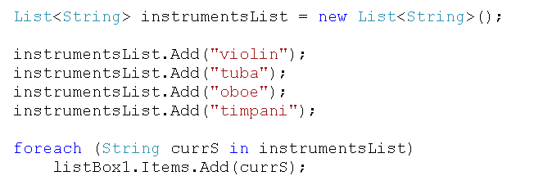
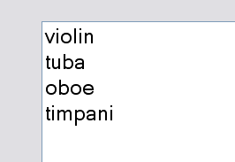
Code Samples
Notes:
List is the most commonly used.
Here is a quick review of how its operators work.

Slide 11

Code Samples
Notes:
Will print what? => 4
Note the use of intermediate variables, rather than stuffing the call to count into the call to Add
This is good practice and makes your code more readable.
In a compiled situation, where number of lines of code isn’t important, always choose readable over short.
(NB: The ToString() is optional here, because the system converts int variables automatically, but since most of the time you need it, it doesn’t hurt to just use it.)

Slide 12
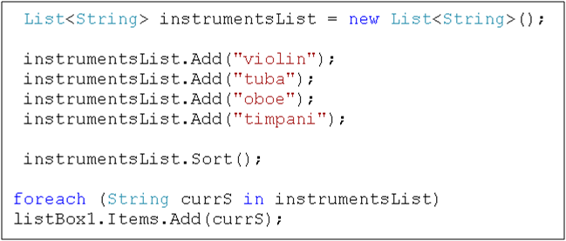
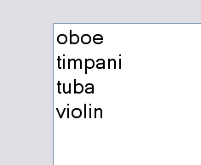
Code Samples
Notes:
This works because strings have a pre-defined compare method.
With complex objects it may not work the way you expect….
Recall that with complex objects you can provide your own. We will explore the technique later.

Slide 13
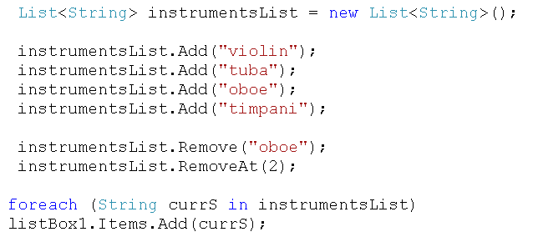
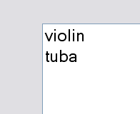
Code Samples
Notes:
Note 0-indexing.
After oboe is gone, there are three elements left, indexed 0,1,2. So RemoveAt(2) removes the last item – timpani.

Slide 14
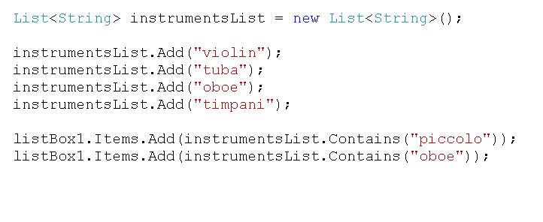
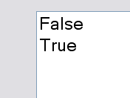
Code Samples

Slide 15
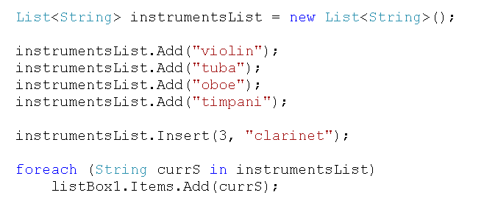
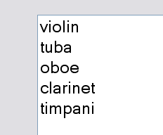
Code Samples
Notes:
Note 0-indexing.
Insert is quite literally insert-at. The specified value becomes the value at 0-indexed position i

Slide 16
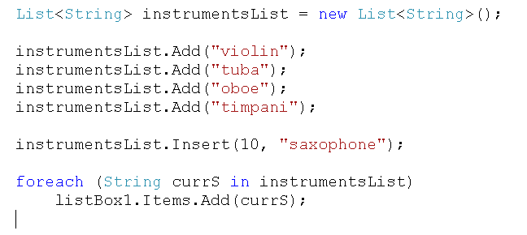
Code Samples
Notes:
Your program will crash, throwing this informative exception….

Slide 17
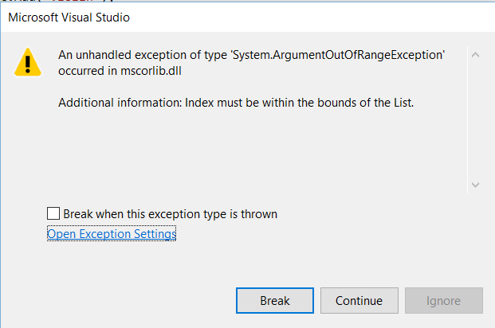
Code Samples
Notes:
Your program will crash, throwing this informative exception
We will see next how you can work with these exceptions, allowing more graceful handling of errors (crashing is not graceful).
For example, a user might inadvertently make a typo on data entry that would cause your code to try to add out of bounds. Crashing and requiring a restart is budget. We can do better.

Slide 18
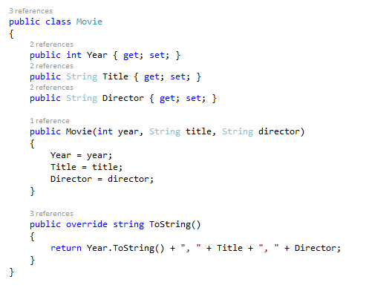
Dictionary
Notes:
Dictionaries are a little more complex, but very, very useful.
It is best to think of a dictionary as a collection, not of values (can be as complex as you like – they can, for example, be user-defined objects) but of key,value pairs
An example….We’re going to make a little database thing of the movies that won the best picture Oscar
(This will be a simple flat-file database. But just FYI, we will be working with the MSSQL RDBMS later in the semester.)
We will have this little class to be a record.
Please note the C# 6.0 syntax for declaring properties (publically accessible class data members)
You should understand why we override ToString.
The primary key will be the year. This works because only one movie wins the Best Movie Oscar each year, so year is unique.

Slide 19
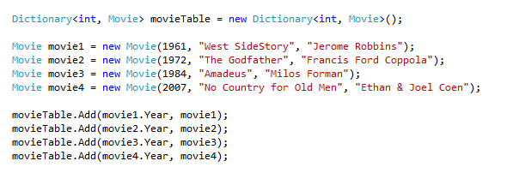
Dictionary
Notes:
Here is how to create a dictionary.
Declaration and Allocation: In Dictionary<t1,t2> t1 is the type of the key; t2 is the type of the value.
We then create some movie objects
We then add each one in, indexed by its own year.
Look very carefully at how this is done...
Note that when working with Dictionary, you need to keep very clear on the difference between the key and the value.
In this case, the key is actually a property of the object which is the value. That’s fine. When you access this property, you get an int, which is what you need for the key.
If this example looks too odd to you, give it plenty of thought.

Slide 20
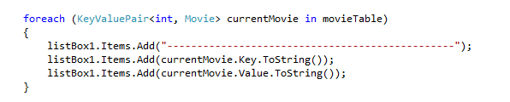
Dictionary
Notes:
And here is how we iterate over a Dictionary
Note that the foreach loop pulls out KeyValuePair objects (you must specify the types, as shown), which have Key and Value properties
You must specify the data types of the key (in this case an int) and the object value (in this case Movie)
As usual with foreach, you then access the current element by the variable name you give it in the loop argument (int this case currentMovie)
The element is of type KeyValuePair, a NET type. It has two properties – Key and Value – which you access as shown
What will this code frag print out? Think about it carefully……
It first calls ToString on the key (so it prints the year as a string); then it calls toString on the Movie(so you get the ToString() method you wrote for the Movie class).

Slide 21
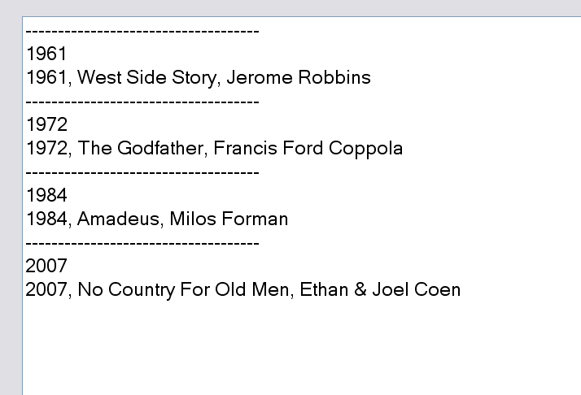
Dictionary
Notes:
Here is the output

Slide 22

Dictionary
Accessing items
Notes:
txtYear.Text is a TextBox on the Form where the user types the search key
You can locate the item simply by indexing into the dictionary with the key value, as shown.
NB: Because it uses [], this looks like an array index – like it should accept 0, 1, 2...
It is not.
It is a key value. (In our example, 1961 or 1972, etc.).
But what if key isn’t there?
The system will throw a keyNotFound exception at statement 2 (more about exceptions next…)

Slide 23
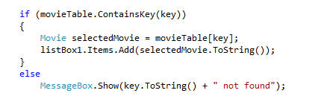
Dictionary
Accessing items safely (method 1)
Notes:
Here is one method for preventing this error
Check first for the key in the table using the ContainsKey method of the dictionary
One architectural note: Because we are concentrating now on the syntax of Dictionaries, we are just dumping all the code in together.
When we actually start building our movieDatabase class, it won’t be responsible for generating output like this.
Why not? => That violates SRP. The MovieDatabase class’s one job is to manage Movies. It shouldn’t know anything about the UI.
To make the database pop up messages and so forth is to couple your user interface and your application logic, which we know is very bad.
How would we really implement it? => The search method returns a Movie, or null. The calling class (which would be the Form in our case) decides what UI to generate.
Start thinking about these things now, every time you see some code...

Slide 24
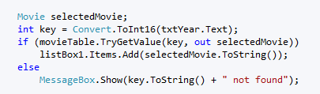
Dictionary
Accessing items safely (method 2)
Notes:
Here is an alternative, which highights a couple of C# syntactic features.
Call TryGetValue, which is a method of all dictionary objects.
This accepts the key and an out parameter – out is “ref but it doesn’t have to have a value first”
It simultaneously does a lookup and, if successful, an assign, and returns true (so the if statement evaluates to true)
If not successful, it returns false
How do you know this method exists?
You don’t. The .NET base classes are big complex beasts with lots of (semi-random) methods and properties.
As you are learning the language, consider it an exploration project. Before you start writing code, it’s worth spending some time reading a book or the MSDN docs to find out all the options and, as in this case, the preferred technique.
Another thing you need to start thinking about is when you would choose method 1 and why, and when you would choose method 2 and why.
In this case, ContainsKey is more readable, and TryGetValue is more efficient (at execution time) because it uses a more efficient fetch operation (see docs for details).
So, unless you are writing a code sample for teaching, you will probably use TryGetValue.
So why do we have ContainsKey at all? ➔ Because there are other circumstances where you might want to test if a key exists, but not actually fetch the value, and in this case ContainsKey is more efficient because it skips the fetch altogether.

Slide 25
Part 2: Exception Handling
Unexpected events during execution cause the system to generate exceptions.
Exceptions are objects that derive from System.Exception
The generated exception is said to be ‘thrown’
Notes:
More (probably getting a little weary by now, but we have a lot of catching up to do…)

Slide 26
Exceptions
Note that exceptions are intended to be used for truly catastrophic, unmanageable, unexpected occurrences.
If you can gracefully catch and recover from an error, it is better to do so.
If you don’t know what to do in the event of an exception, don’t handle it. Let the program crash.
Notes:
Try-Catch is not a substitute for good error checking

Slide 27
Some Common Exceptions
System.OutOfMemoryException
System.NullReferenceException
System.InvalidCastException
System.ArrayTypeMismatchException
System.IndexOutOfRangeException
System.ArithmeticException
System.DivideByZeroException
System.OverFlowException
System.SqlException
Notes:
Some of the more common exceptions
These are fairly self-explanatory
But there are lots more, and you can also define your own and throw them yourself if you want

Slide 28
Exception Handling
Keywords
try
catch
finally
Notes:
The three relevant keywords

Slide 29
Exception Handling - try
Surround the code to be protected with a ‘try block’
try
{
// potentially risky code here…
}
Notes:
If the code in the try block fails (i.e. something happens that will cause a system exception to be thrown), the exception isn’t immediately thrown (as it would be without the try block)
Instead, the system holds up a bit, and checks to see if the programmer has defined a catch block for that exception..

Slide 30
Exception Handling - catch
Follow with a ‘catch’ block for each exception you want to handle
try
{
// code that might try to divide by zero
}
catch (DivideByZeroException)
{
// code to deal with a divide by zero, here
}
Notes:
If an exception is thrown by the code in the try block, the program doesn’t immediately crash.
First it looks to see if there is a following catch block for that exception
If so, it executes the catch block instead of crashing, and just continues on from there.
If not, it crashes.

Slide 31
Exception Handling - catch
You can attach a name to the exception argument in the catch block.
This allows you to access the exception’s data
try
{
// code that might try to divide by zero
}
catch (DivideByZeroException ex)
{
// code to deal with a divide by zero, here
MessageBox.Show(ex.Message);
}
Notes:
Exception objects all have a class data member Message.
This is a standard string for system messages, or you can supply your own message, if you choose to manually throw an exception (we see how in a minute)
They also have other things, like info about the call stack, that you might want to look at on occasion.
See the documentation for details

Slide 32
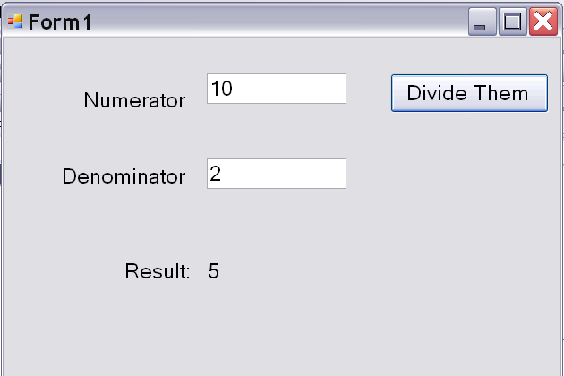
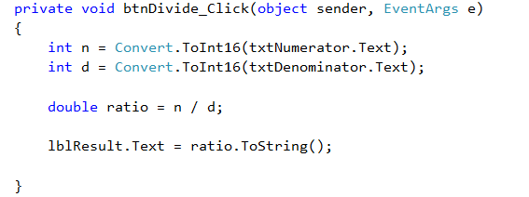
Example
Notes:
Consider this situation
The code as written produces the output ‘5’ shown in the image

Slide 33
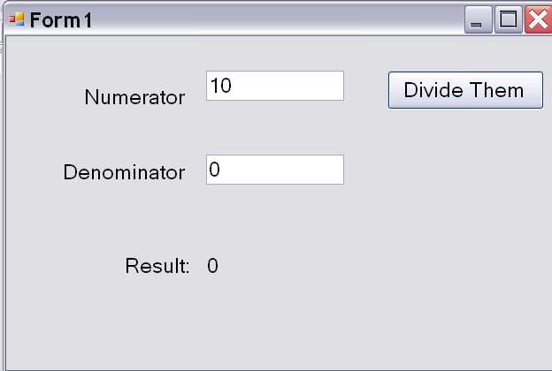
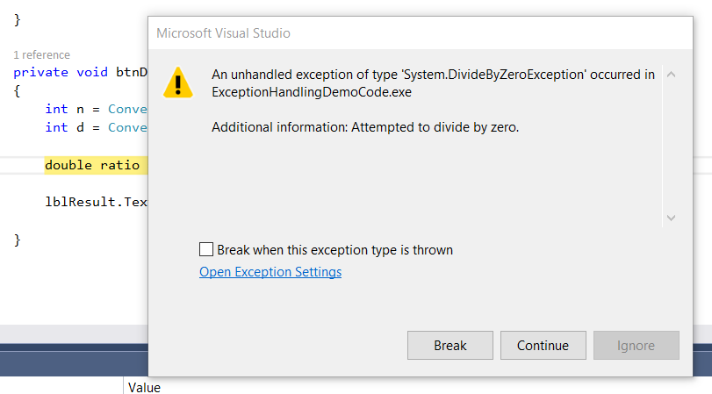
Example
Notes:
But if the user types 0 into the denominator, you get an exception
This exception is unhandled
Unhandled exceptions cause the program to terminate.
Not very nice for the user.

Slide 34
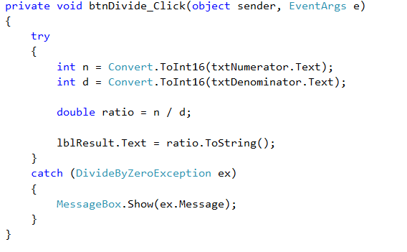
Example
Notes:
Here is how you use try-catch to prevent the crash

Slide 35
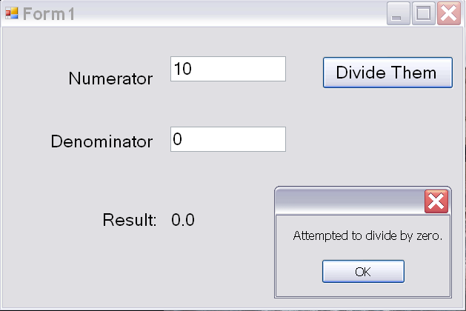
Example
Notes:
Which is admittedly more graceful.
The program hasn’t crashed
The user can continue, etc.

Slide 36
Multiple Catch Blocks
try
{
// code that might throw various exceptions
}
catch (exceptionType1 ex)
{
// exceptionType1 handling code
}
catch (exceptionType2 ex)
{
//exceptionType2 handling code
}
etc.....
Notes:
Note that a catch block with no argument, or with argument type Exception will catch all exceptions, preventing crashes
But this is considered bad practice, as you almost certainly can’t deal sensibly with “any exception”

Slide 37
Multiple Catch Blocks
The system will match the exception thrown to the correct catch block
If no catch block is found for a thrown exception, the application will terminate and display the generic exception dialogue.

Slide 38
Exception Handling - finally
try
{
// code that might throw various exceptions
}
catch (exceptionType1 ex)
{
// exception1 handling code
}
finally
{
// clean up code
}
Notes:
Code in the finally block is executed after the try terminates, or, if an exception is thrown, after the corresponding catch terminates.
This is useful for freeing up resources, closing file pointers, etc.
If there is an uncaught exception in the try, the finally may or may not be executed, depending on exactly what happened in the try (see docs for details).
This is another reason for catching all the exceptions you know how to deal with.

Slide 39
Throwing your own exceptions
You can create your own special purpose exceptions by descending from System.ApplicationException, as from any other base class. (Left as an exercise.)
Prefer to use the existing exceptions, rather than creating your own.
You can throw system exceptions if you wish to control their data properties (example to follow)
You can rethrow an exception from inside its catch block if you want to do some processing on it, then let it be handled by a surrounding block.
Notes:
It’s generally better to use existing exceptions if you can find an appropriate one, as they provide extra data in the Exception object

Slide 40
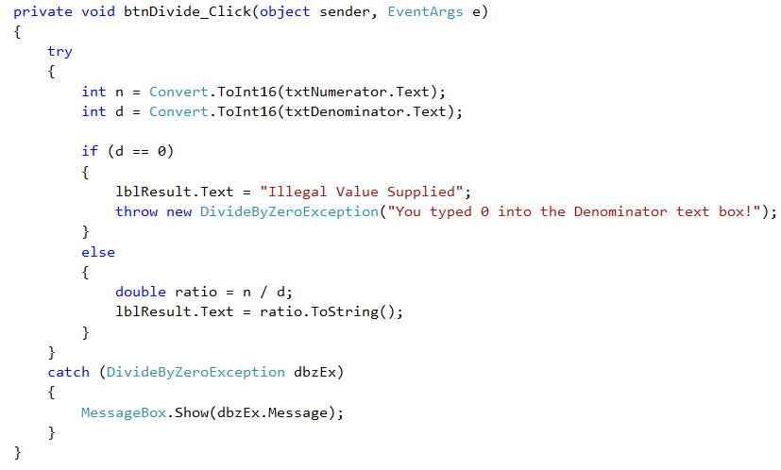
Example
Notes:
Here you are calling the Div…ion constructor. It accepts a string for the Message property, so you can override the default message this way if you wish.

Slide 41
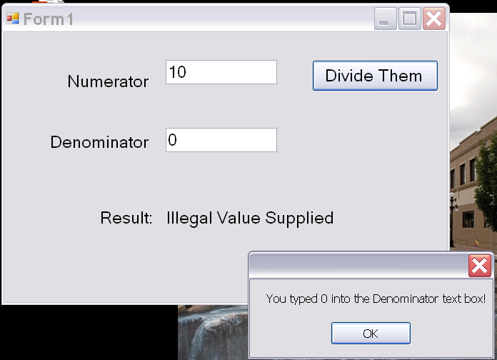
Example
Notes:
Changed the message to fit the slide onto the PPT…

Slide 42
Guidelines
Bad exception handling is dangerous.
Use good error checking to avoid exception situations whenever you can.
Don’t catch an exception if you don’t know what to do with it.
Notes:
Basically, when you write exception handling code, you are overriding the application’s desire to crash.
Make sure that this makes sense. Applications only crash when something bad has happened.

Slide 43
Practical
See handout

